Slide 1


PROFESSIONAL TAX (MAHARASHTRA) — PAYMENT & CHALLAN GUIDE
PT Payment
Step by Step
A large-format, screenshot walkthrough for making your monthly Professional Tax (PTRC/PTEC) payment on the MahaGST Portal.

Slide 2
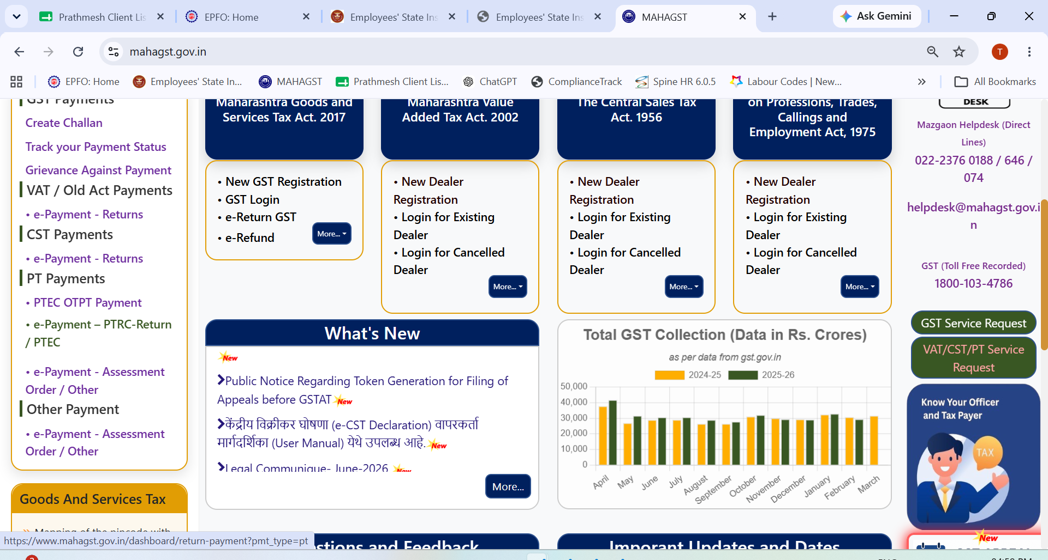
PROFESSIONAL TAX (MAHARASHTRA)
STEP 1 OF 3
1
Open e-Payment
On mahagst.gov.in, go to PT Payments in the left menu and click 'e-Payment – PTRC-Return / PTEC'.
Shree Wealth Consultancy — Professional Tax (Maharashtra) Guide
1 / 3

Slide 3

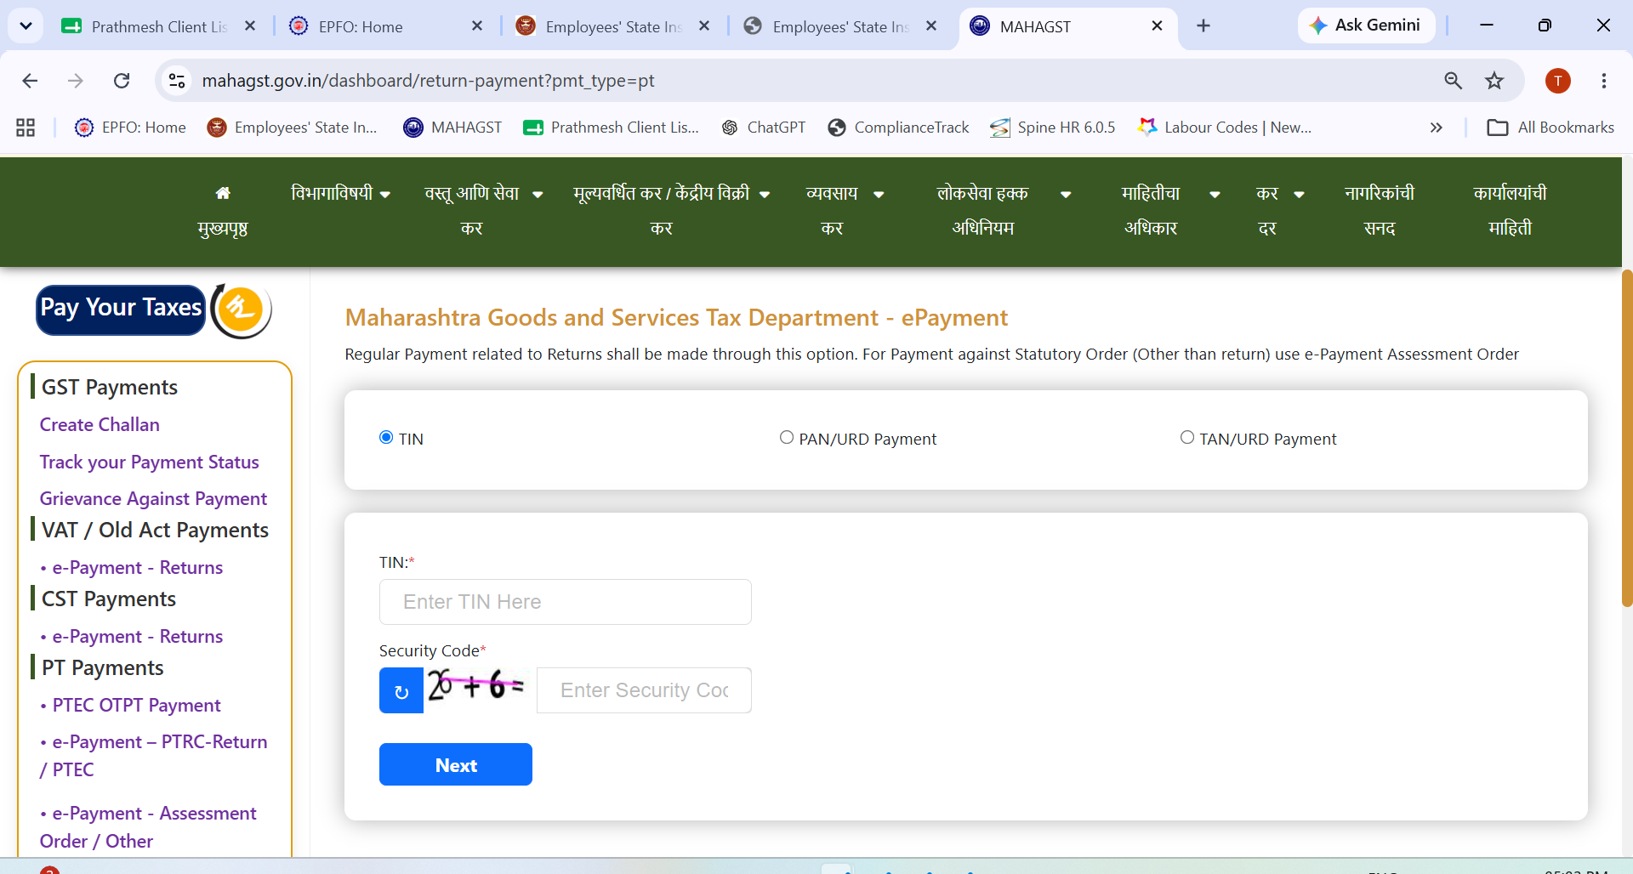
PROFESSIONAL TAX (MAHARASHTRA)
STEP 2 OF 3
2
Enter TIN
Fill in your 11-digit TIN and the security code shown, then click Next.
Shree Wealth Consultancy — Professional Tax (Maharashtra) Guide
2 / 3

Slide 4

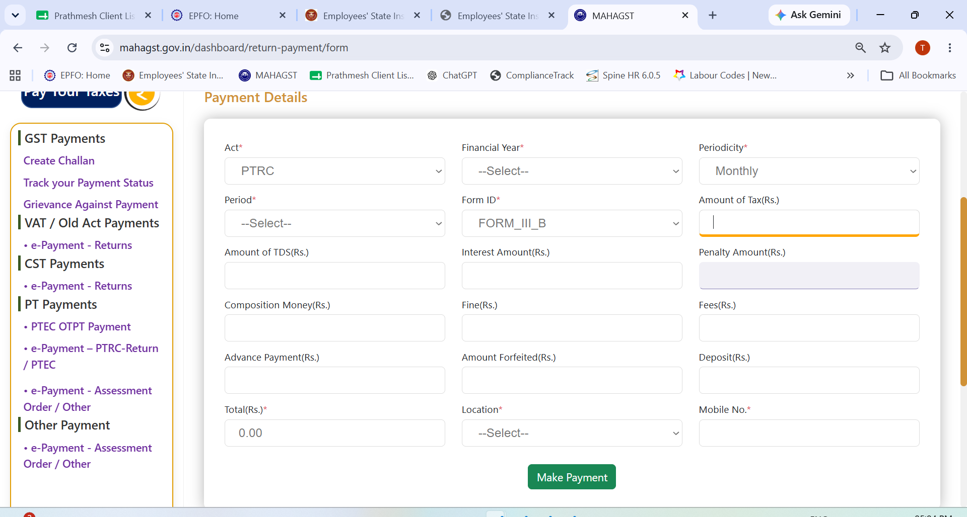

PROFESSIONAL TAX (MAHARASHTRA)
STEP 3 OF 3
3
Fill Payment Details & Pay
Confirm the Act, Financial Year and Periodicity, select the Period, enter the Amount of Tax, and click 'Make Payment'.
If your PT periodicity is Annual, select the exact financial year. If Monthly, select the NEXT month's period — e.g. paying for June 2026 means selecting July 2026.
Shree Wealth Consultancy — Professional Tax (Maharashtra) Guide
3 / 3

Slide 5




Need Help With Compliance?
Shree Wealth Consultancy manages your Professional Tax (Maharashtra) filings end-to-end — reach out before your next due date.
Monthly compliance tracker
Due dates managed on one calendar, across every filing.
Challan & return filing
We prepare, verify, and file on your behalf, on time, every time.
Audit-ready records
All paid challans and receipts archived and retrievable on demand.
Shree Wealth Consultancy
HR & Labour Law Consultant • +91 81047 89205 • info@shreewealthconsultancy.in • www.shreewealthconsultancy.in

