Slide 1


LABOUR WELFARE FUND (MAHARASHTRA) — PAYMENT & CHALLAN GUIDE
LWF Payment
Step by Step
A large-format, screenshot walkthrough for making your half-yearly Labour Welfare Fund contribution on the MLWB Employer Portal.

Slide 2

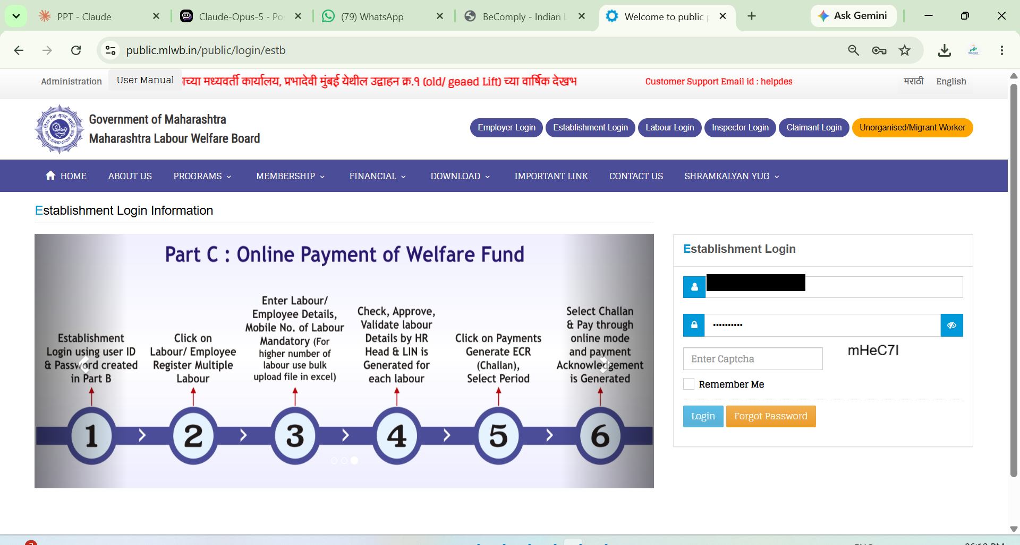
LABOUR WELFARE FUND (MAHARASHTRA)
STEP 1 OF 4
1
Establishment Login
Go to public.mlwb.in/public/login/estb — enter your Establishment User ID and Password, complete the captcha, and click Login.
Shree Wealth Consultancy — Labour Welfare Fund (Maharashtra) Guide
1 / 4

Slide 3

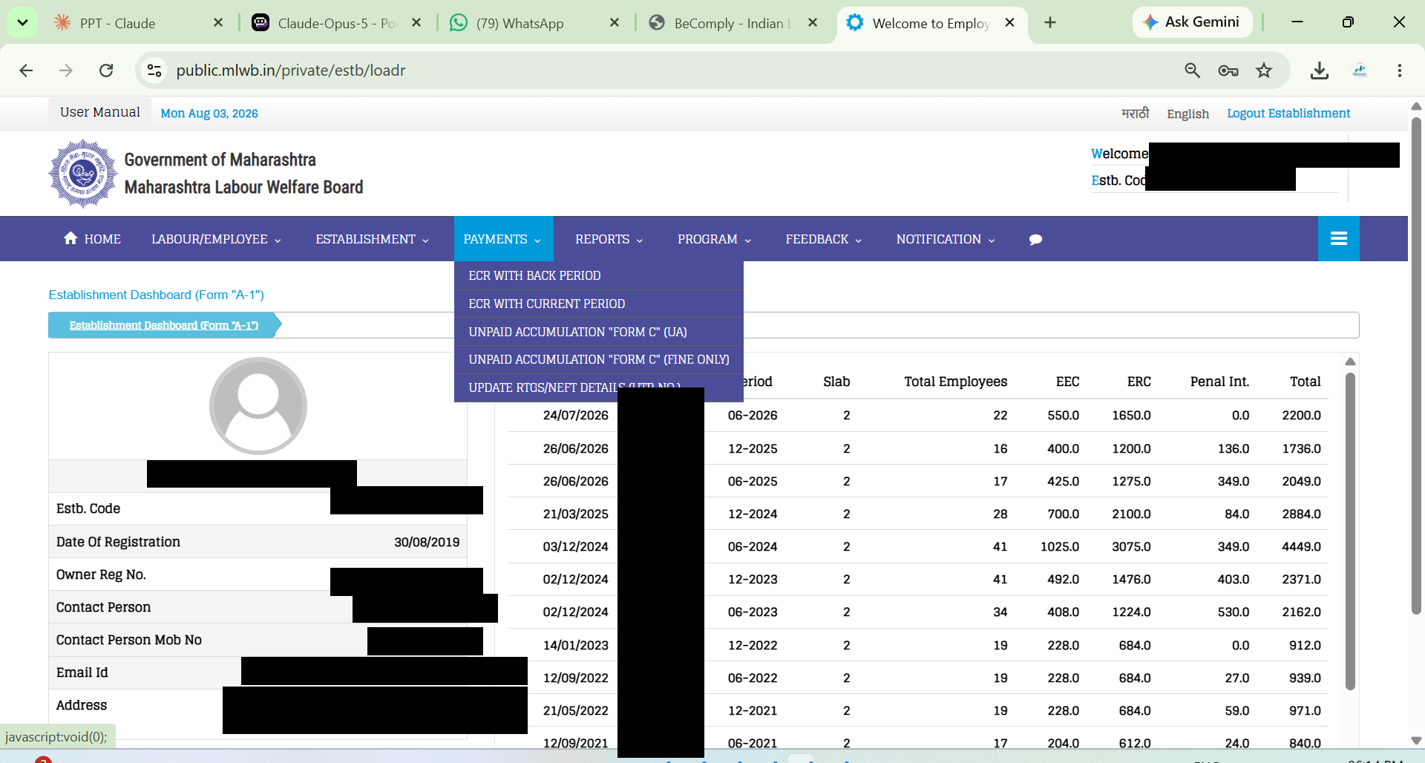
LABOUR WELFARE FUND (MAHARASHTRA)
STEP 2 OF 4
2
Payments → ECR with Current Period
From the top menu, open Payments and select 'ECR WITH CURRENT PERIOD'.
Shree Wealth Consultancy — Labour Welfare Fund (Maharashtra) Guide
2 / 4

Slide 4

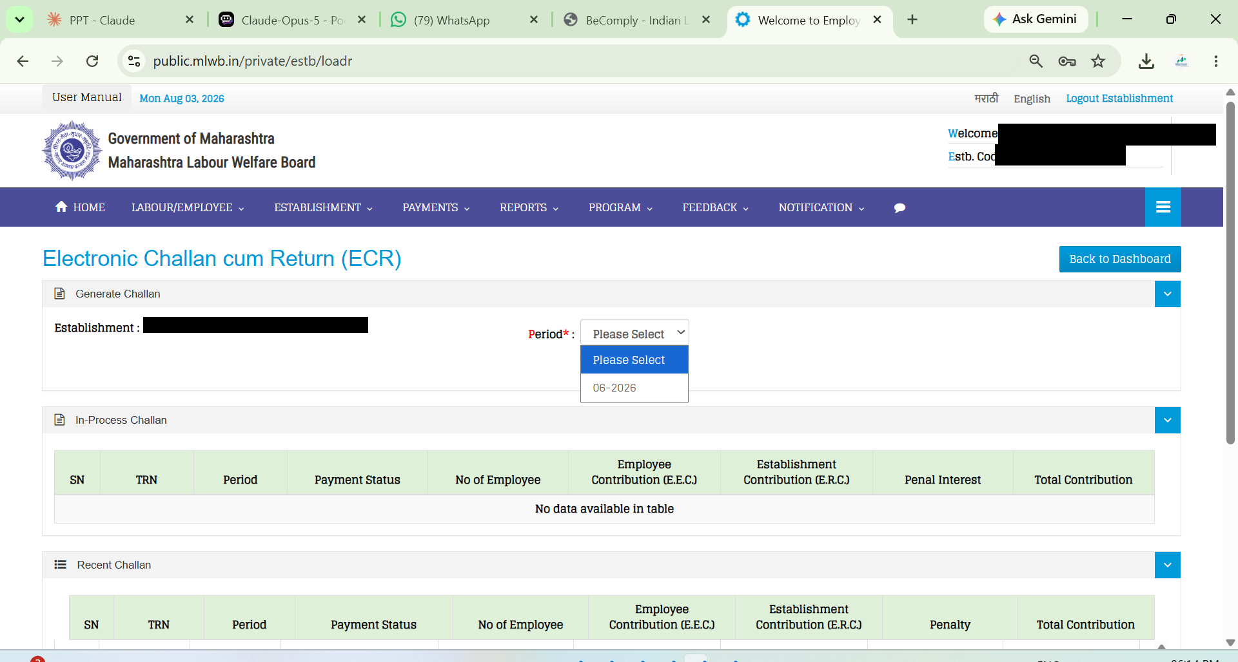
LABOUR WELFARE FUND (MAHARASHTRA)
STEP 3 OF 4
3
Select the Period
Open the Period dropdown under Generate Challan and choose the correct half-year cycle (e.g. 06-2026).
Shree Wealth Consultancy — Labour Welfare Fund (Maharashtra) Guide
3 / 4

Slide 5

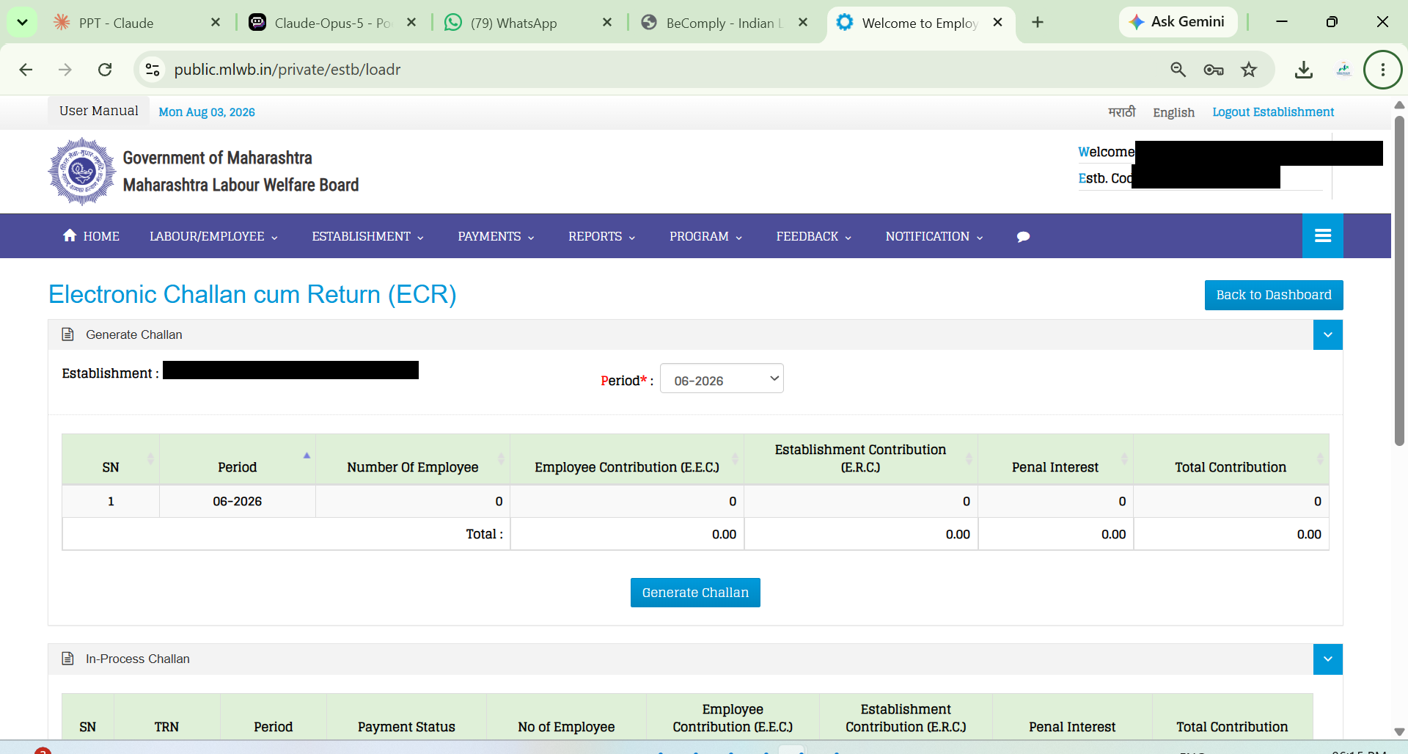

LABOUR WELFARE FUND (MAHARASHTRA)
STEP 4 OF 4
4
Generate Challan & Pay
Review the contribution totals for the period, then click 'Generate Challan' and complete the payment. If a subscription page appears, click Skip.
Note: an MLWF challan is only valid for 24 hours — if unpaid within that window, you'll need to regenerate it.
Shree Wealth Consultancy — Labour Welfare Fund (Maharashtra) Guide
4 / 4

Slide 6



Need Help With Compliance?
Shree Wealth Consultancy manages your Labour Welfare Fund (Maharashtra) filings end-to-end — reach out before your next due date.
Monthly compliance tracker
Due dates managed on one calendar, across every filing.
Challan & return filing
We prepare, verify, and file on your behalf, on time, every time.
Audit-ready records
All paid challans and receipts archived and retrievable on demand.
Shree Wealth Consultancy
HR & Labour Law Consultant • +91 81047 89205 • info@shreewealthconsultancy.in • www.shreewealthconsultancy.in

