Slide 1


ESIC — PAYMENT & CHALLAN GUIDE
ESIC Payment
Step by Step
A large-format, screenshot walkthrough for making your monthly ESIC contribution payment on the ESIC Employer Portal.

Slide 2

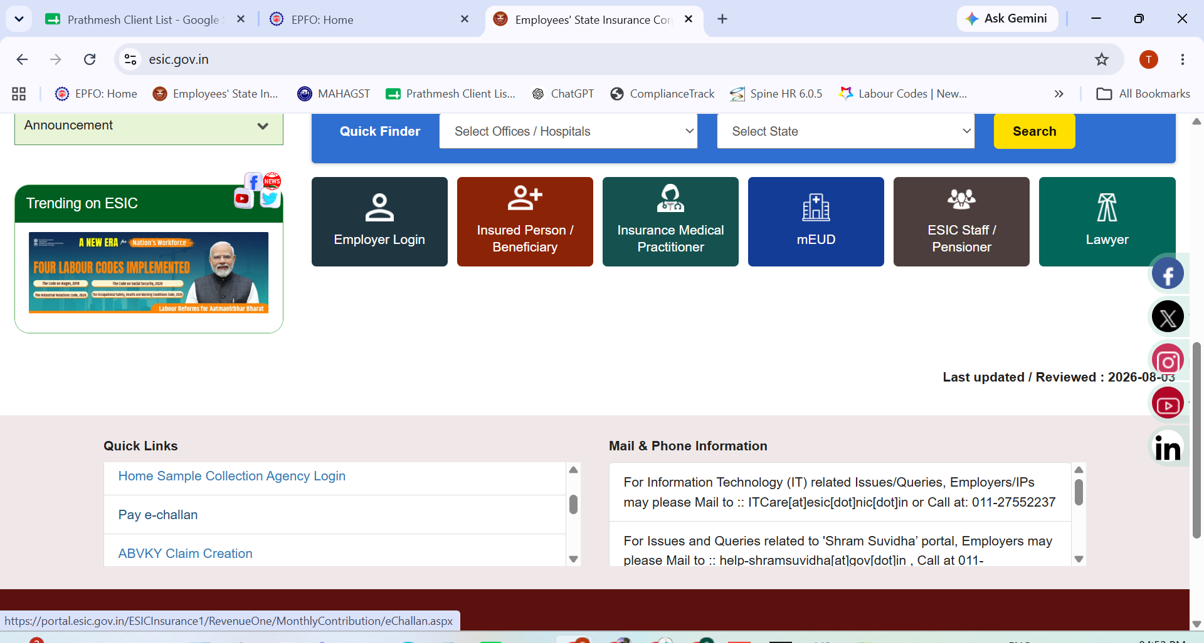
ESIC
STEP 1 OF 4
1
Open e-Payment
Go to esic.gov.in. Under Quick Links (bottom-left of the homepage), find and click 'Pay e-Challan'.
Shree Wealth Consultancy — ESIC Guide
1 / 4

Slide 3

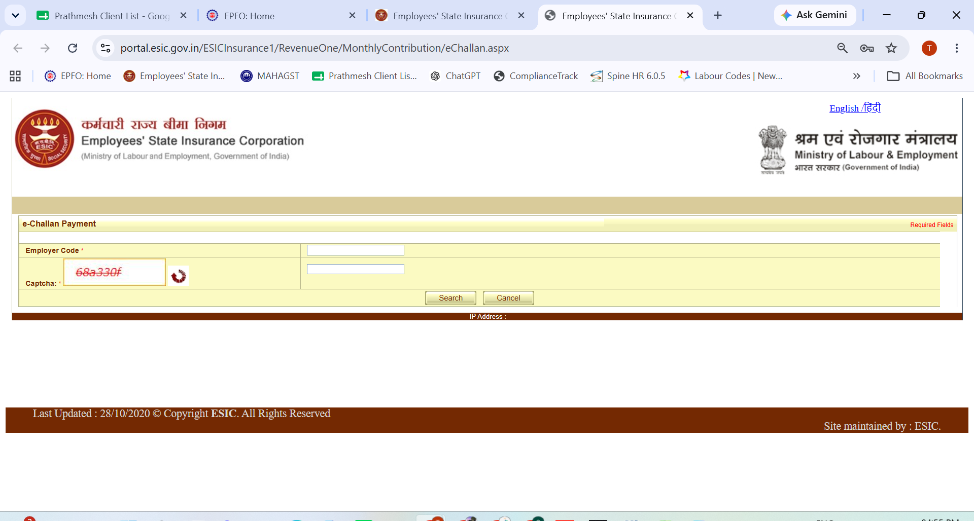
ESIC
STEP 2 OF 4
2
Enter Employer Code
Fill in your Employer Code and the captcha shown, then click Search.
Shree Wealth Consultancy — ESIC Guide
2 / 4

Slide 4

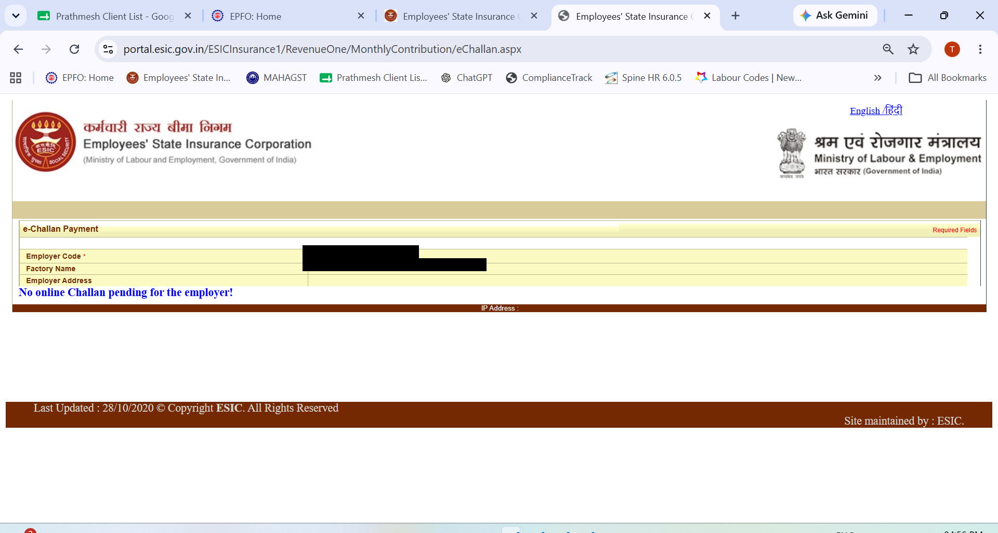
ESIC
STEP 3 OF 4
3
Confirm Employer Details
The portal displays your Factory Name and Employer Address, and lists any online challan pending for payment.
Shree Wealth Consultancy — ESIC Guide
3 / 4

Slide 5

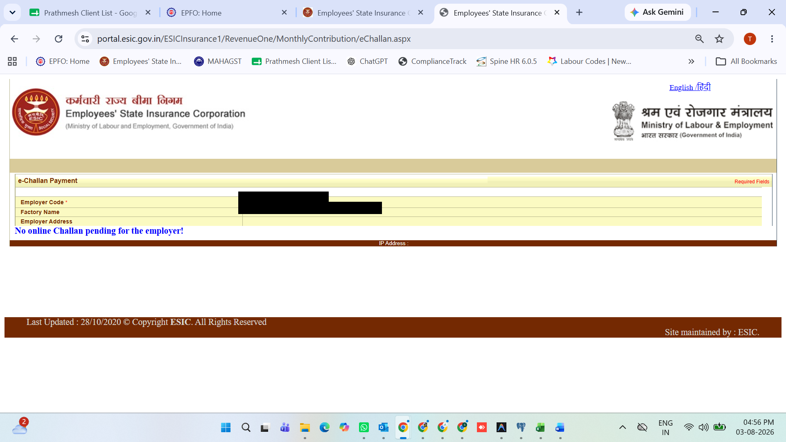
ESIC
STEP 4 OF 4
4
Pay the Challan
Where a challan is pending, check the amount, month and challan number, then click 'Pay'.
Shree Wealth Consultancy — ESIC Guide
4 / 4

Slide 6



Need Help With Compliance?
Shree Wealth Consultancy manages your ESIC filings end-to-end — reach out before your next due date.
Monthly compliance tracker
Due dates managed on one calendar, across every filing.
Challan & return filing
We prepare, verify, and file on your behalf, on time, every time.
Audit-ready records
All paid challans and receipts archived and retrievable on demand.
Shree Wealth Consultancy
HR & Labour Law Consultant • +91 81047 89205 • info@shreewealthconsultancy.in • www.shreewealthconsultancy.in

